Slide 1
Everything BLUEcloud Mobile
Shelbi Schollenberger | Product Manager

Slide 2
Today’s Agenda
Intuitive library access for your patrons with current features
Next generation features to carry your library into the future

Slide 3
Patron Self-Service
Barcode and RFID

Slide 4
Click & Collect
Patron interface

Slide 5
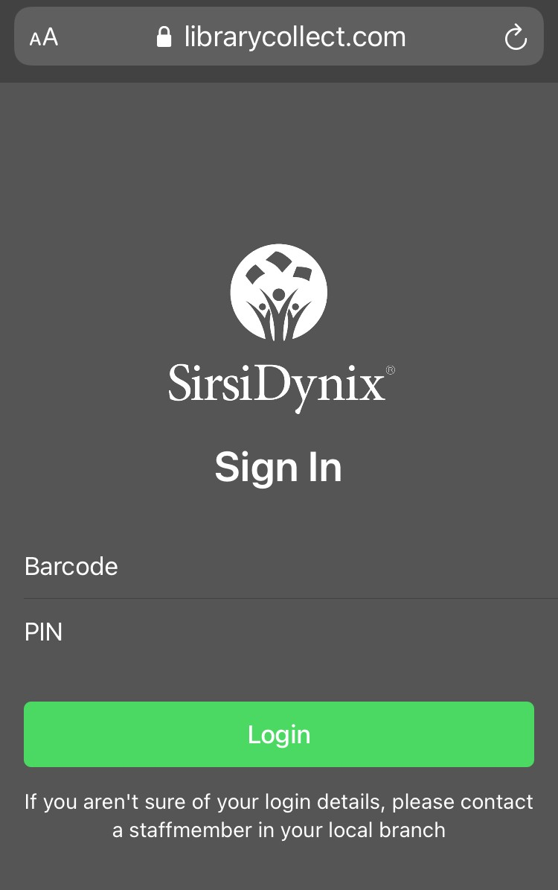
Browser Access
For those patrons without a smartphone, a browser-based version can be used to access Click & Collect

Slide 6
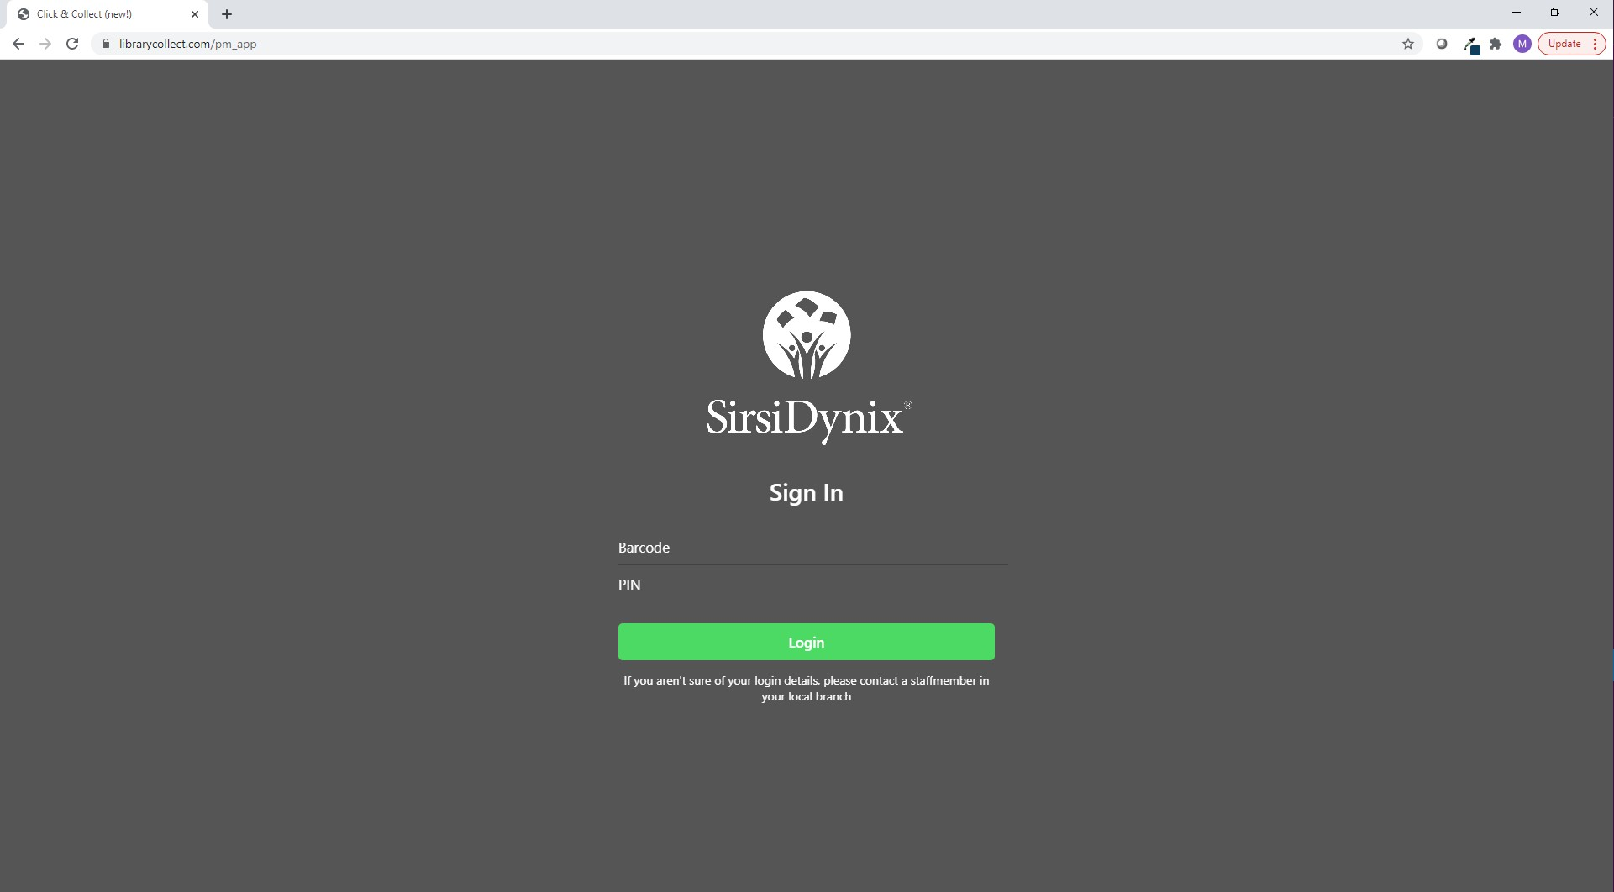
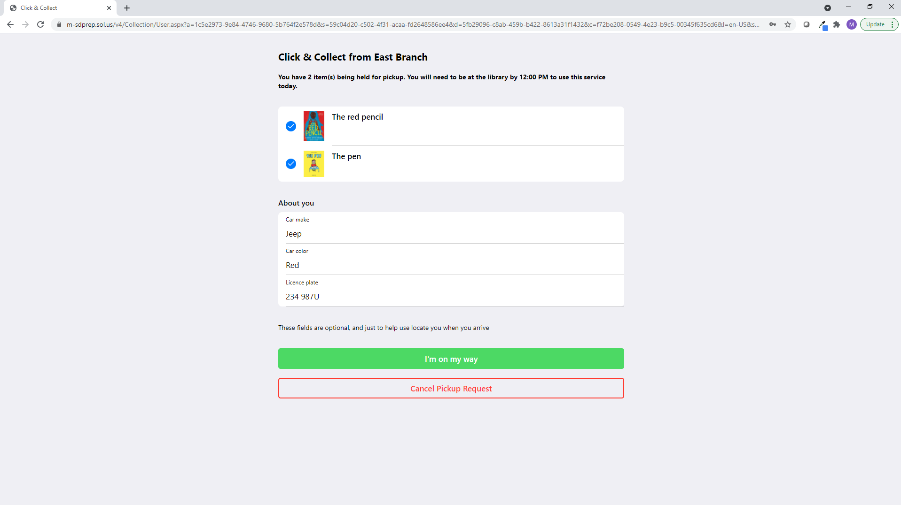
Browser Access
For those patrons without a smartphone, a browser-based version can be used to access Click & Collect

Slide 7
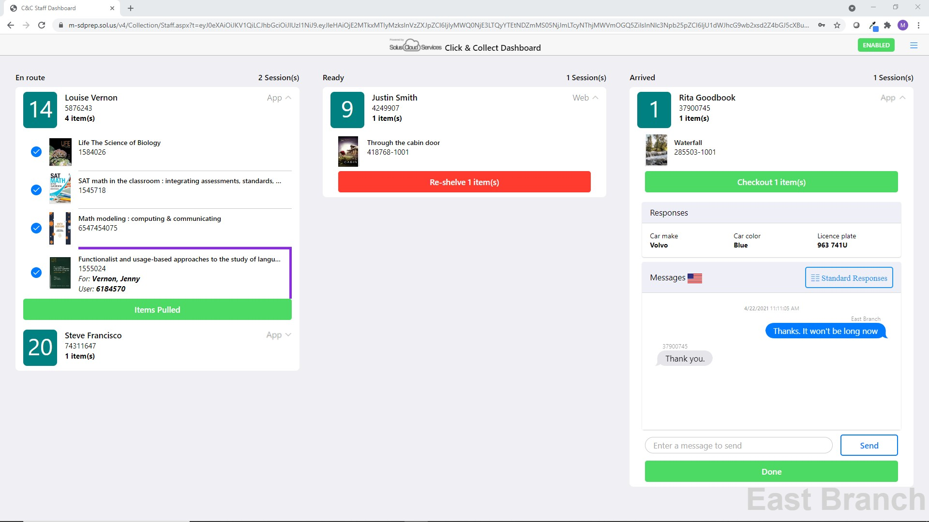
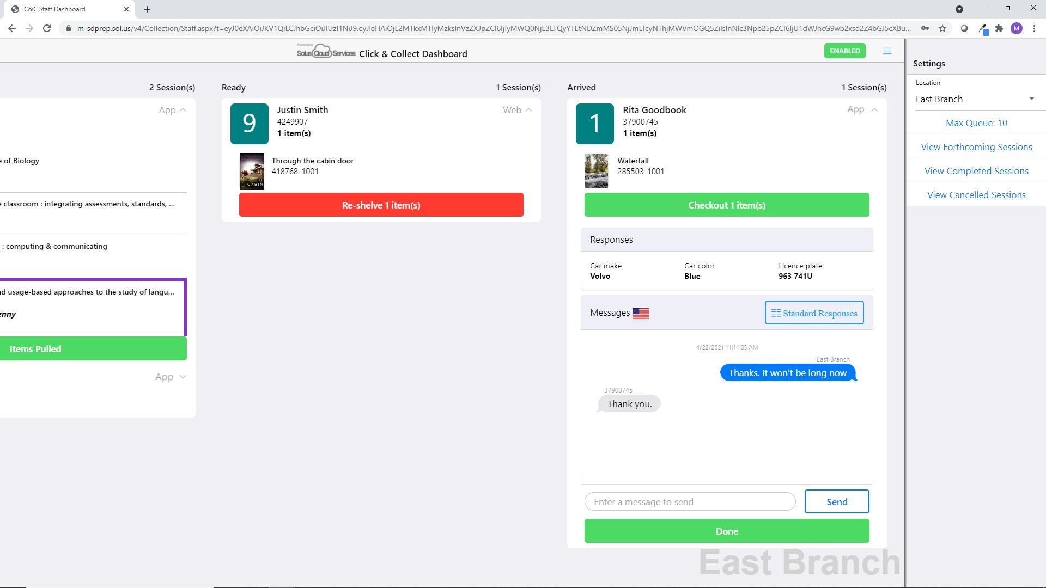
Click & Collect
Staff dashboard

Slide 8
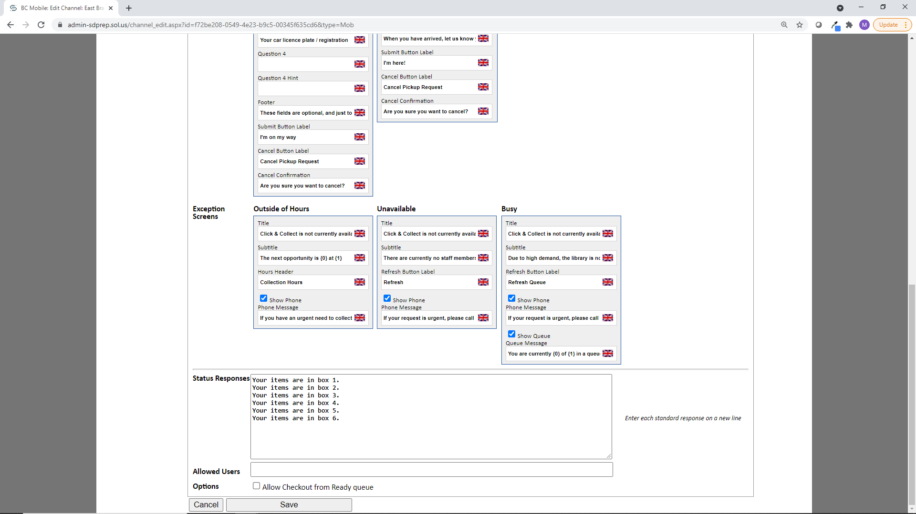
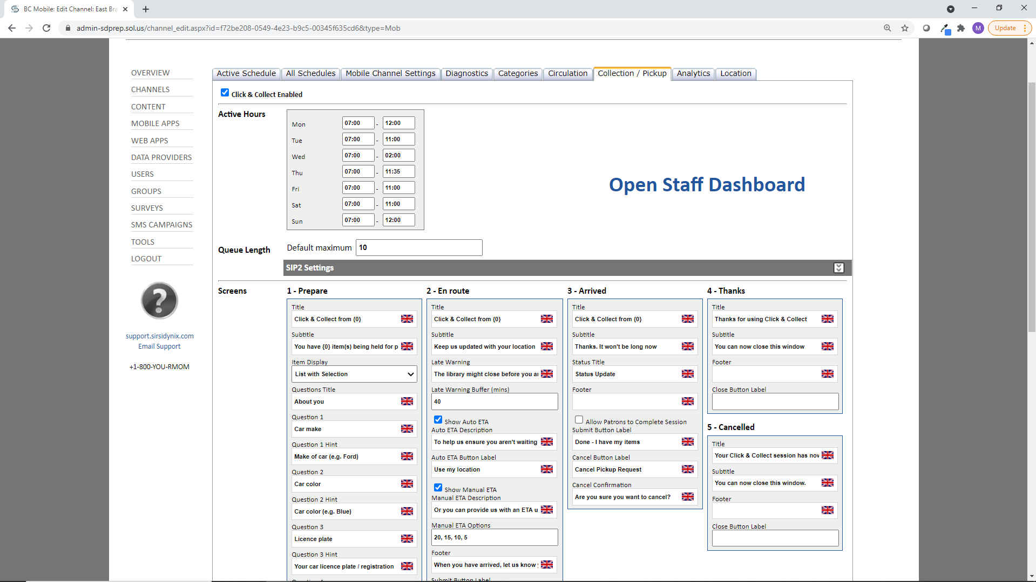
Click & Collect
Configuration options

Slide 9
What’s next?
Visual indicators of items that are over due or ready for pickup
Option to display physical and digital holds separate
Option to edit display of hold statues in the app
Additions to Click & Collect
My Lists functionality

Slide 10
Thank you!

